Slide 1

Recurrent Neural Networks
Notation
deeplearning.ai

Slide 2
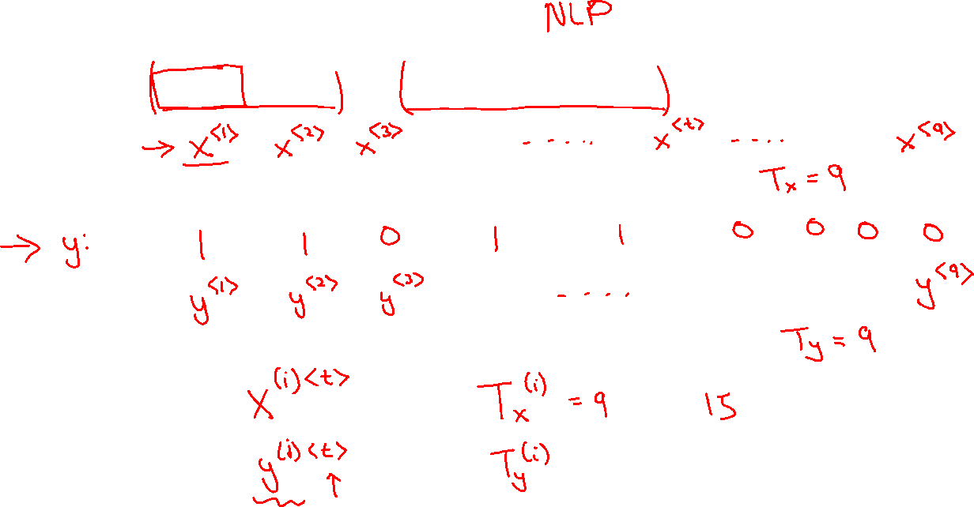
Motivating example
x:
Harry Potter and Hermione Granger invented a new spell.

Slide 3
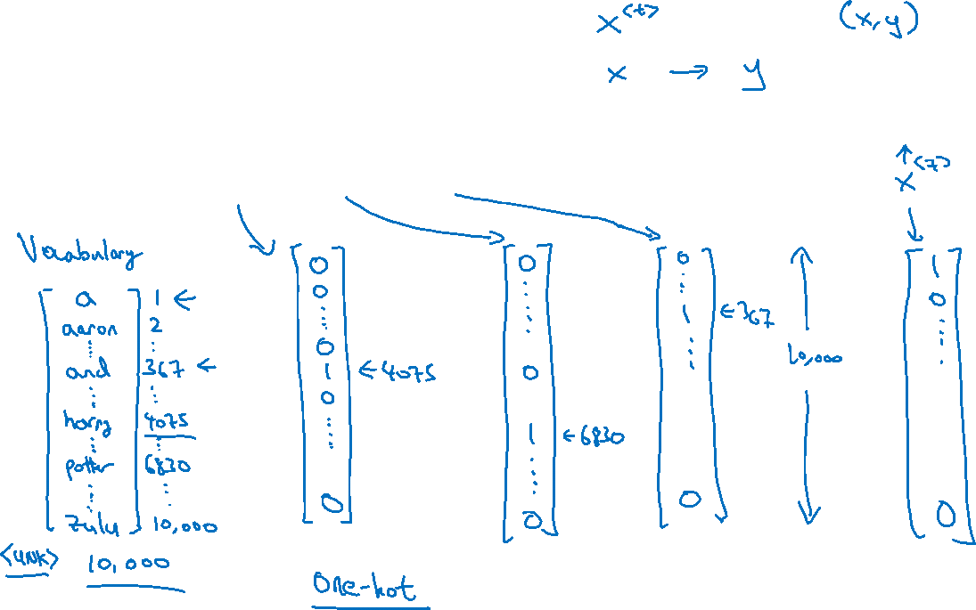





Representing words
x:
Harry Potter and Hermione Granger invented a new spell.
$$x^{<1>}$$
$$x^{<2>}$$
$$x^{<3>}$$
$$⋯$$
$$x^{<9>}$$

Slide 4
Representing words
x:
Harry Potter and Hermione Granger invented a new spell.
$$x^{<1>}$$
$$x^{<2>}$$
$$x^{<3>}$$
$$⋯$$
$$x^{<9>}$$
And = 367
Invented = 4700
A = 1
New = 5976
Spell = 8376
Harry = 4075
Potter = 6830
Hermione = 4200
Gran… = 4000

